Slide 1
Teradata CoE
Teradata Lab Course
CONTENTS:
1)
2)
3)
The Quantile Function
Top SQL Command Cheat Sheet
View Functions

Slide 2
Teradata CoE
Teradata Lab Course
The Quantile Function

Slide 3
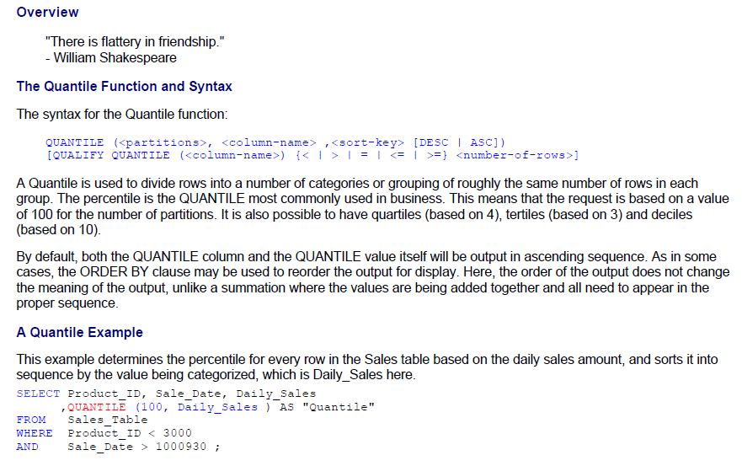
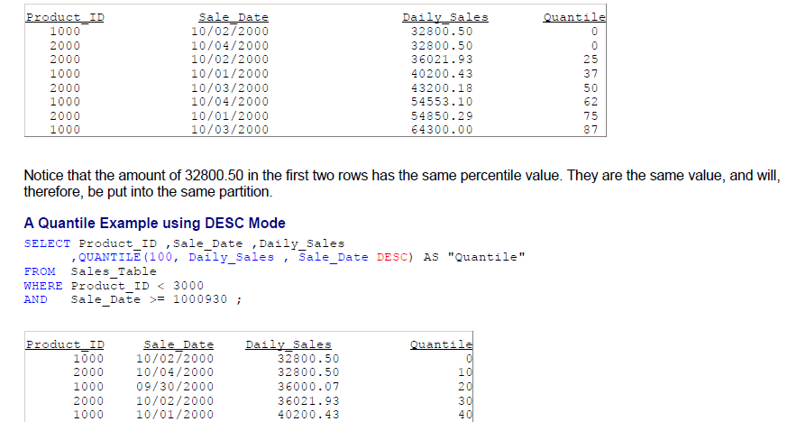
Teradata CoE
Teradata Lab Course
The Quantile Function

Slide 4
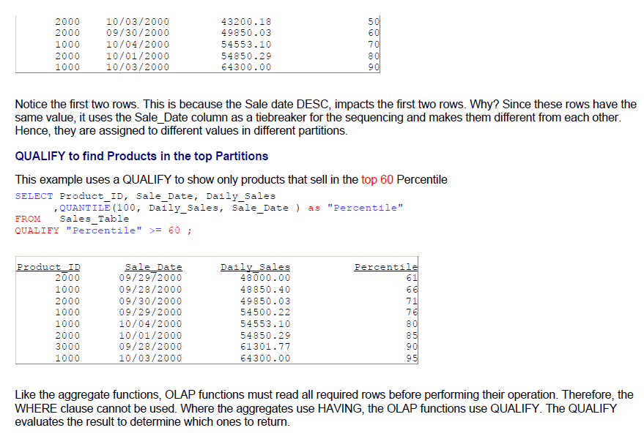
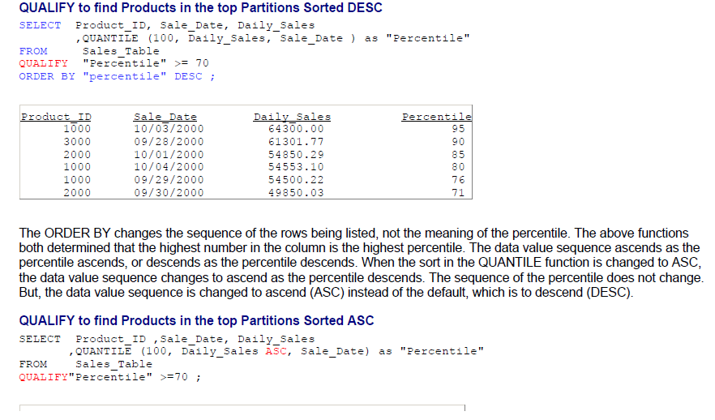
Teradata CoE
Teradata Lab Course

Slide 5
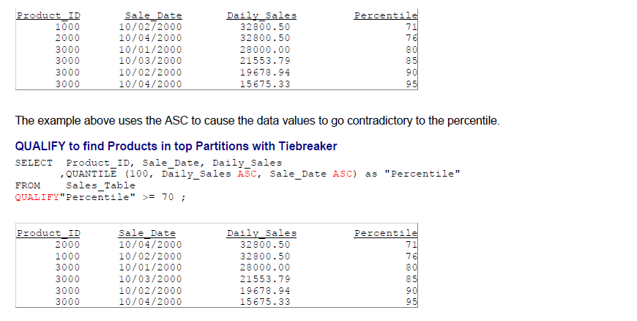
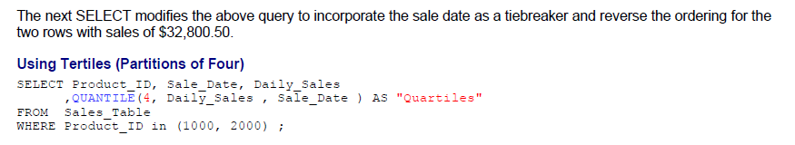
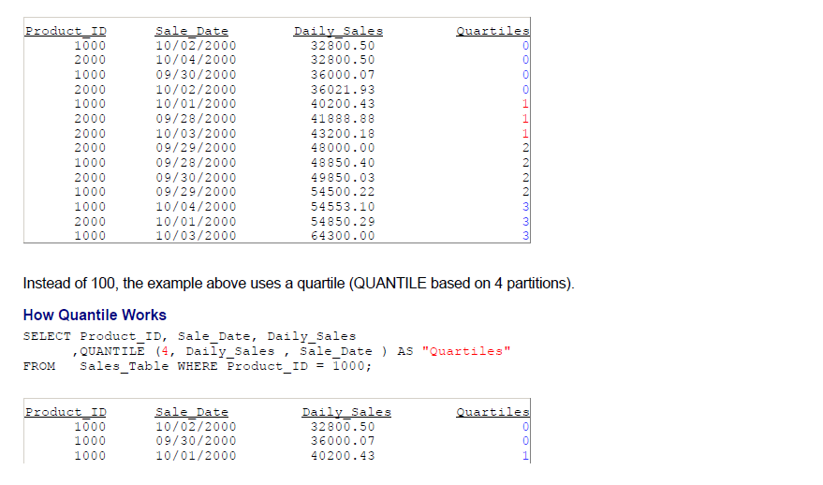
Teradata CoE
Teradata Lab Course

Slide 6
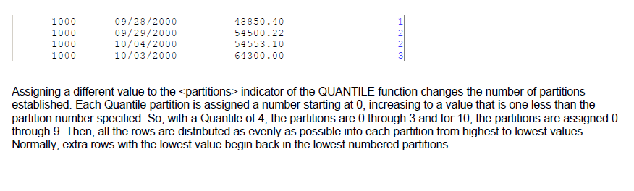
Teradata CoE
Teradata Lab Course

Slide 7
Teradata CoE
Teradata Lab Course
Top
SQL Commands Cheat Sheet

Slide 8
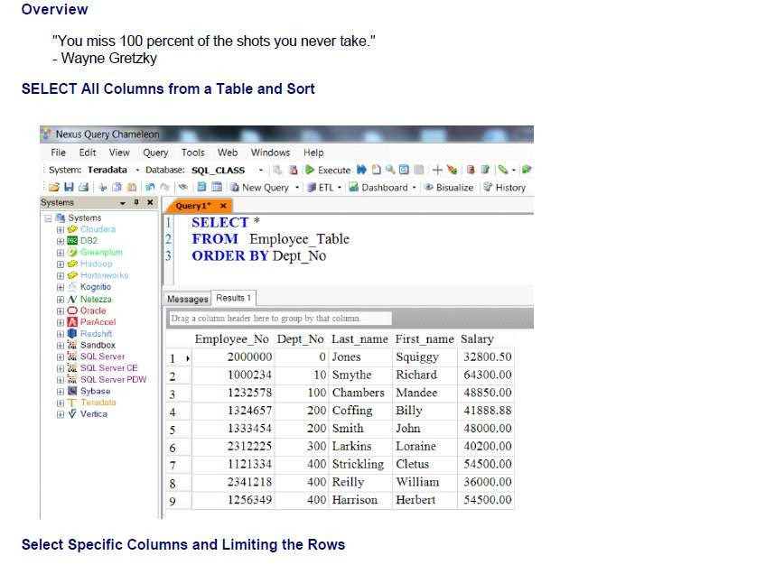
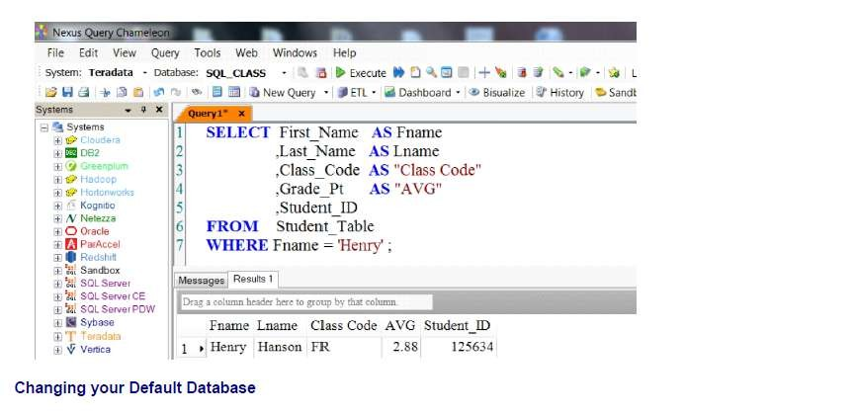
Teradata CoE
Teradata Lab Course
Top SQL Commands Cheat Sheet

Slide 9
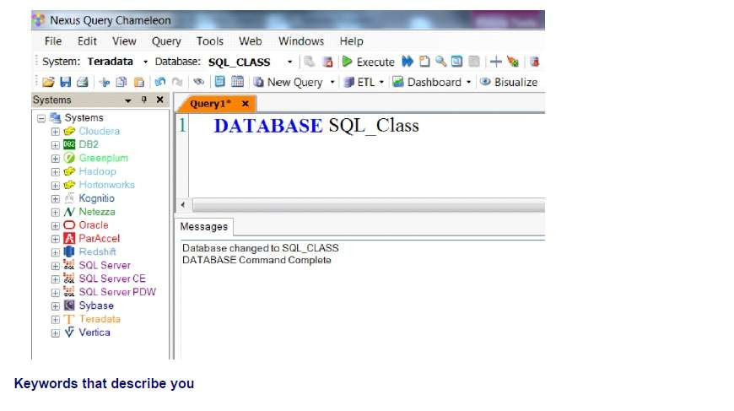
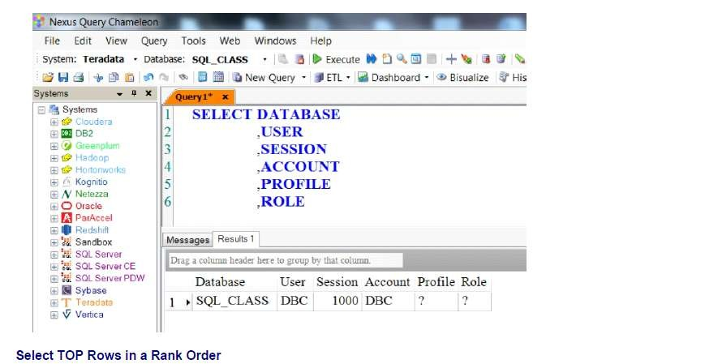
Teradata CoE
Teradata Lab Course

Slide 10
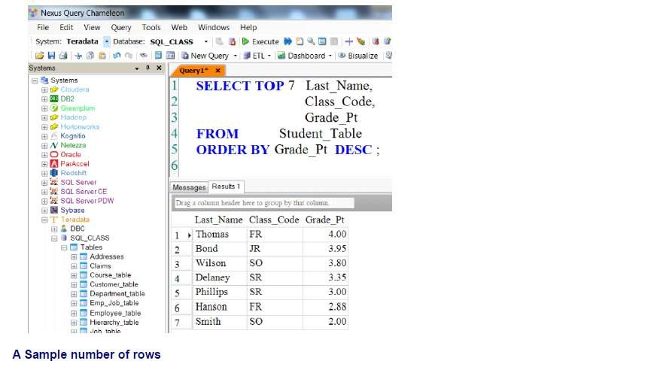
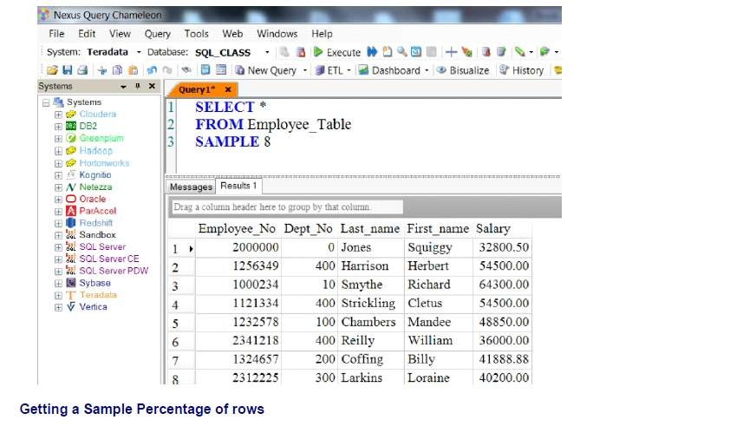
Teradata CoE
Teradata Lab Course

Slide 11
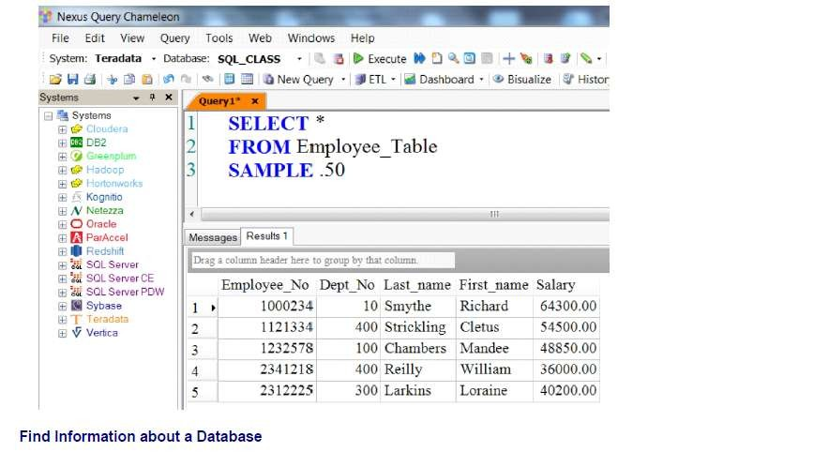
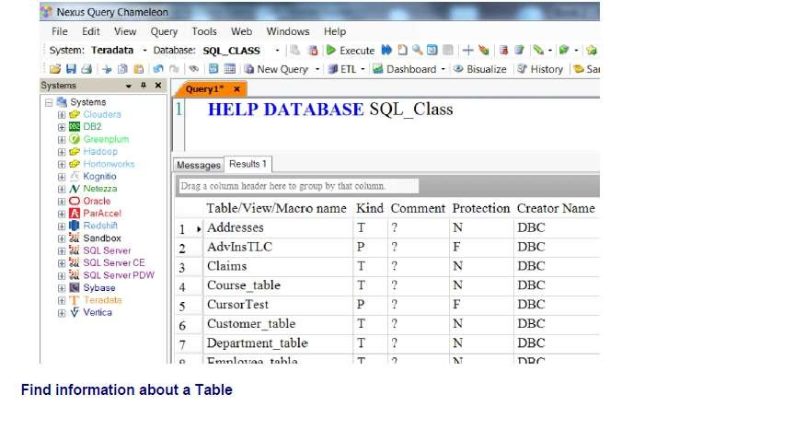
Teradata CoE
Teradata Lab Course

Slide 12
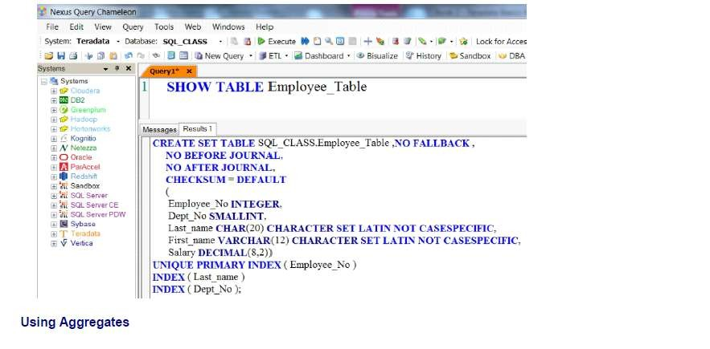
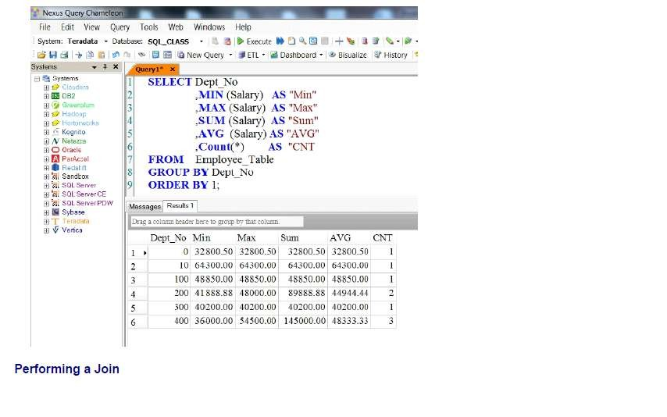
Teradata CoE
Teradata Lab Course

Slide 13
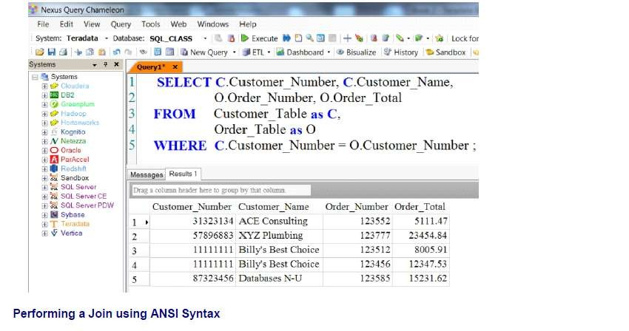
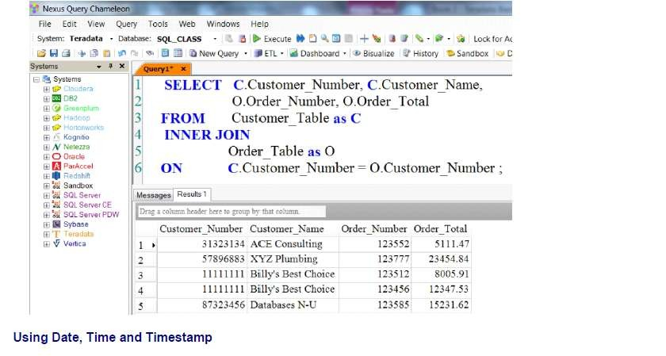
Teradata CoE
Teradata Lab Course

Slide 14
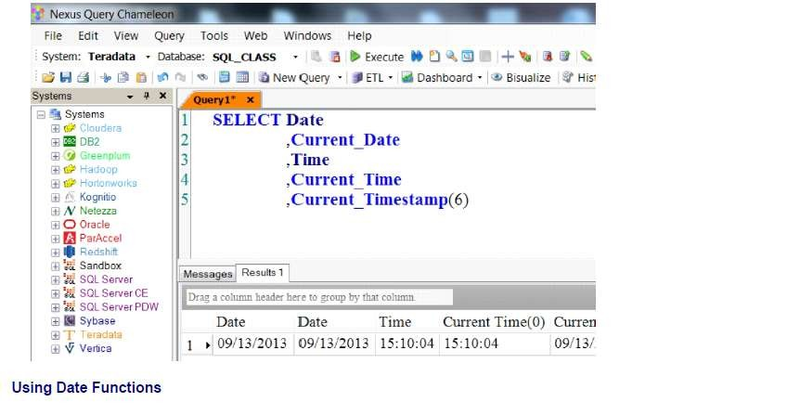
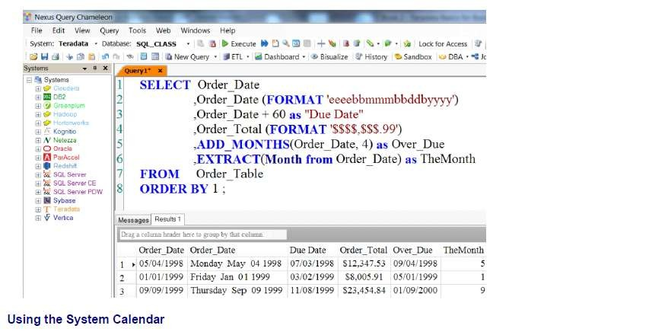
Teradata CoE
Teradata Lab Course

Slide 15
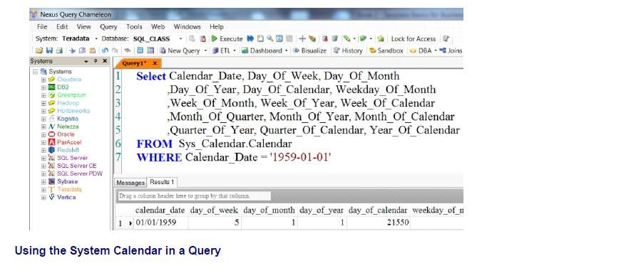
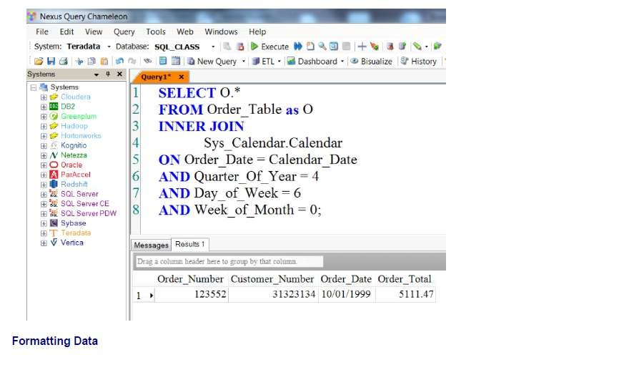
Teradata CoE
Teradata Lab Course

Slide 16
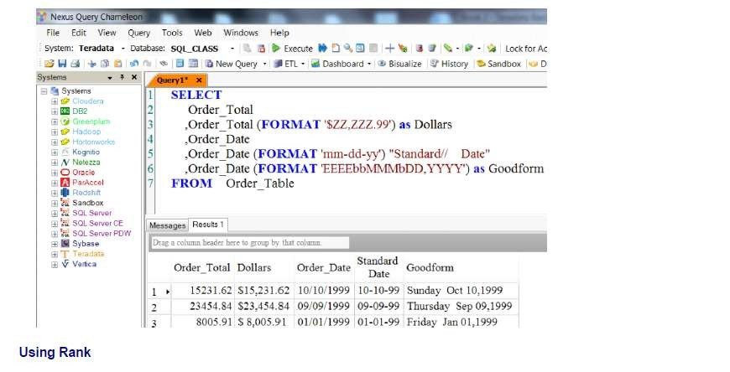
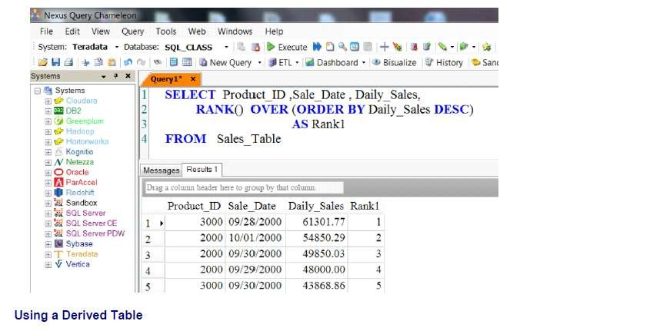
Teradata CoE
Teradata Lab Course

Slide 17
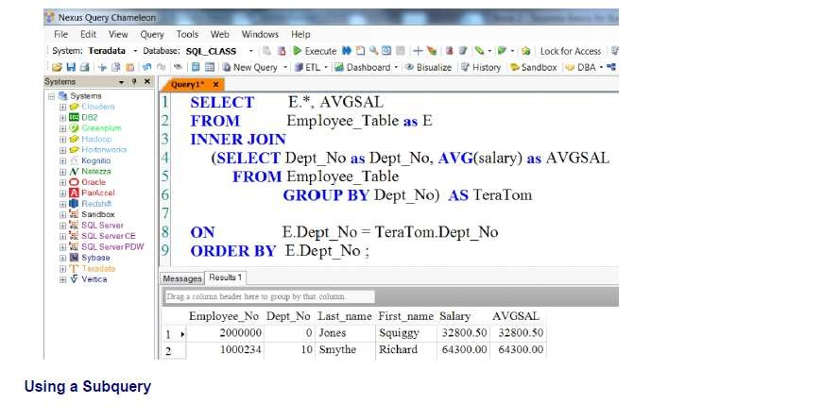
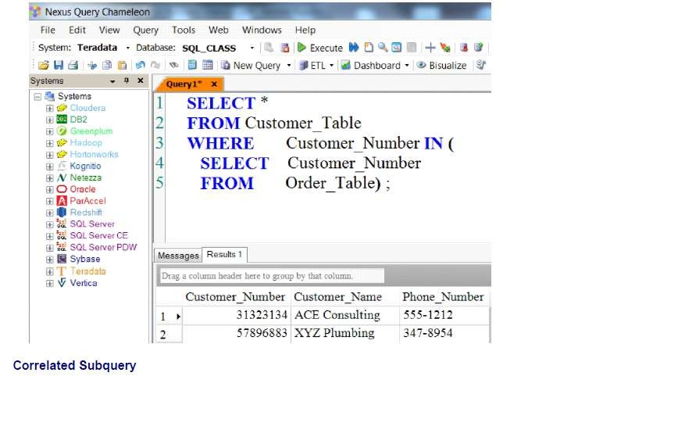
Teradata CoE
Teradata Lab Course

Slide 18
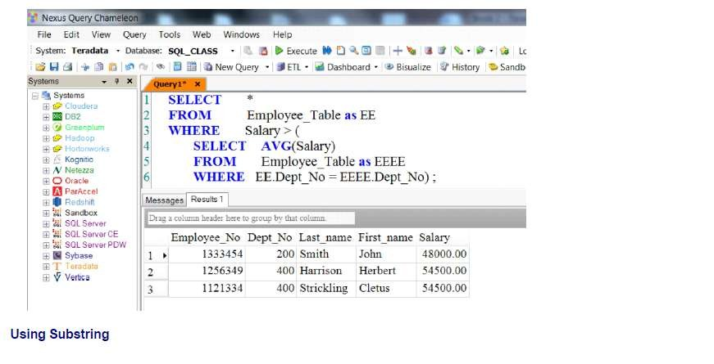
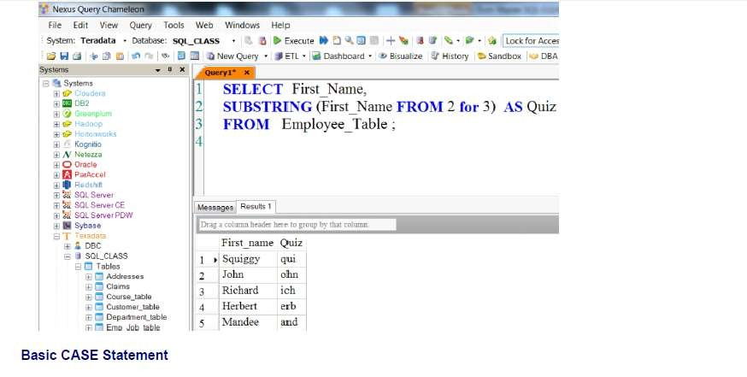
Teradata CoE
Teradata Lab Course

Slide 19
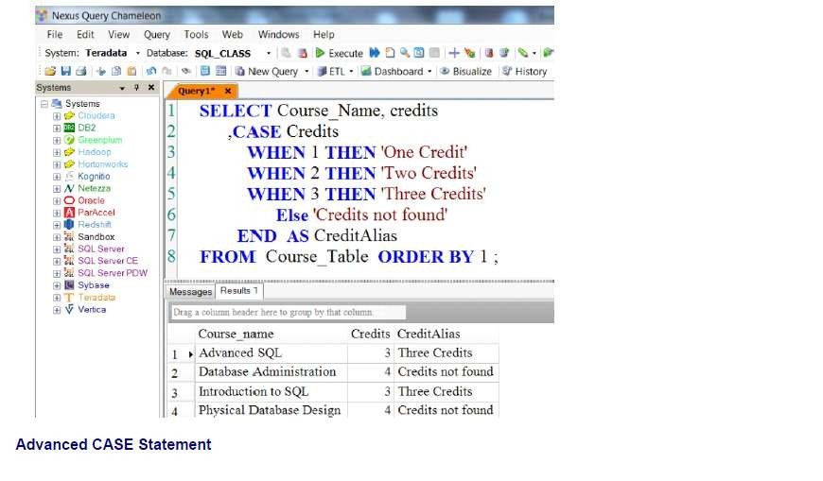
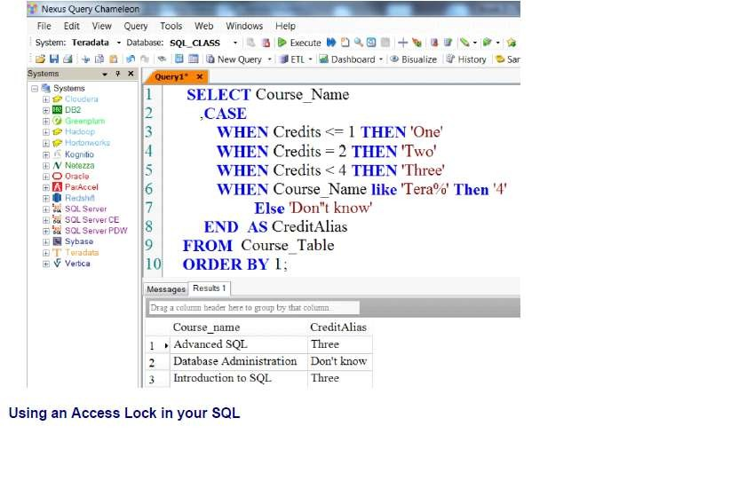
Teradata CoE
Teradata Lab Course

Slide 20
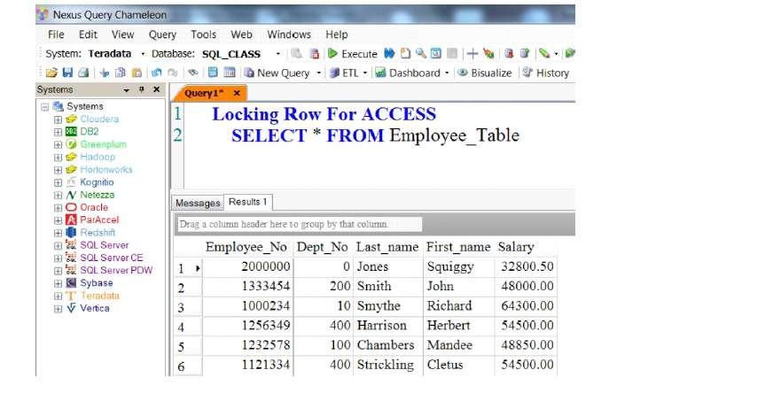
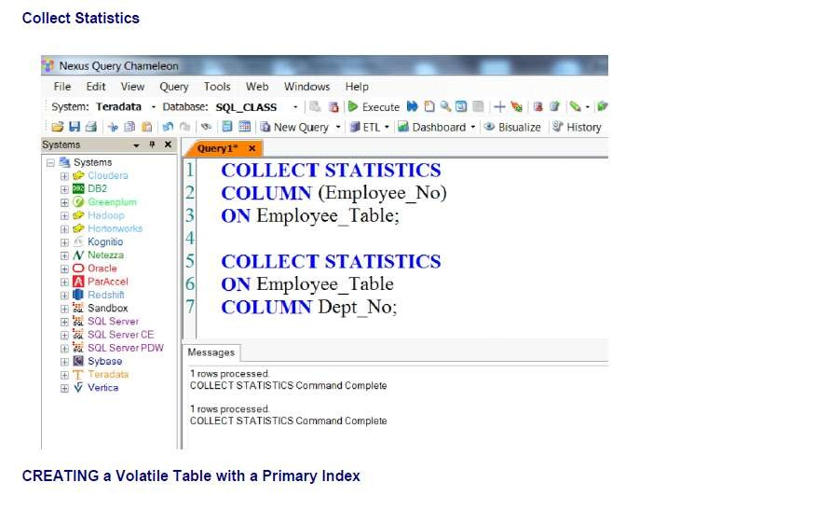
Teradata CoE
Teradata Lab Course

Slide 21
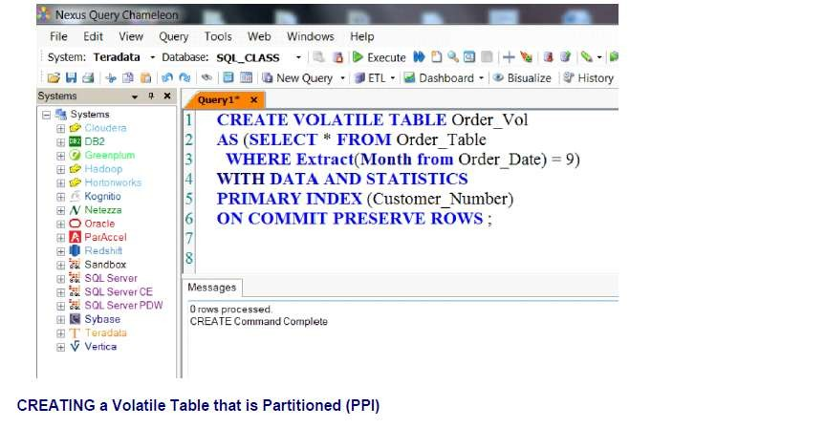
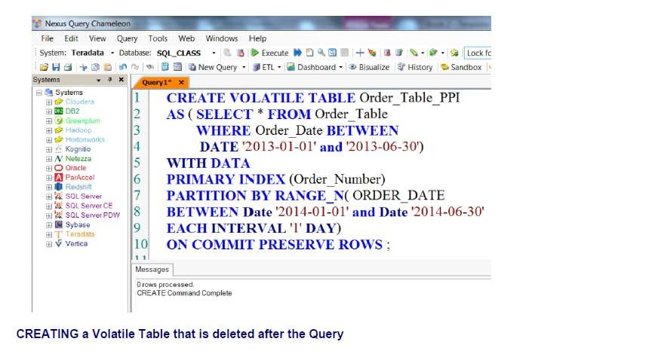
Teradata CoE
Teradata Lab Course

Slide 22
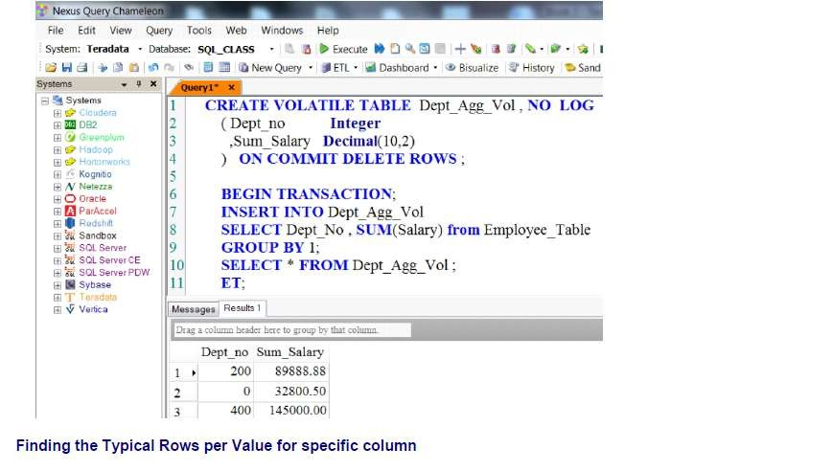
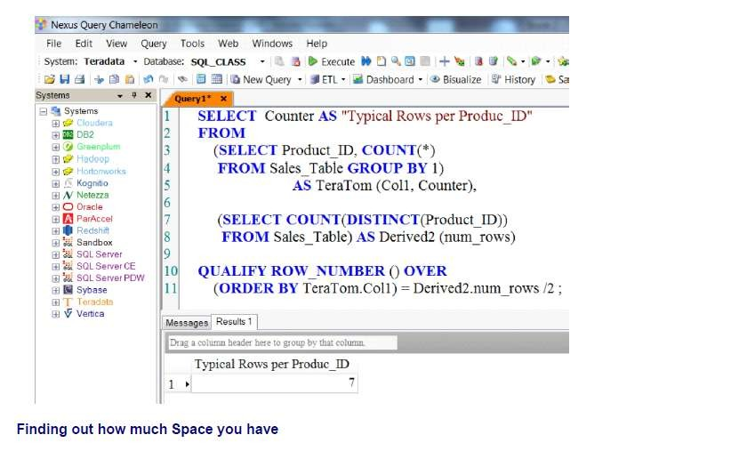
Teradata CoE
Teradata Lab Course

Slide 23
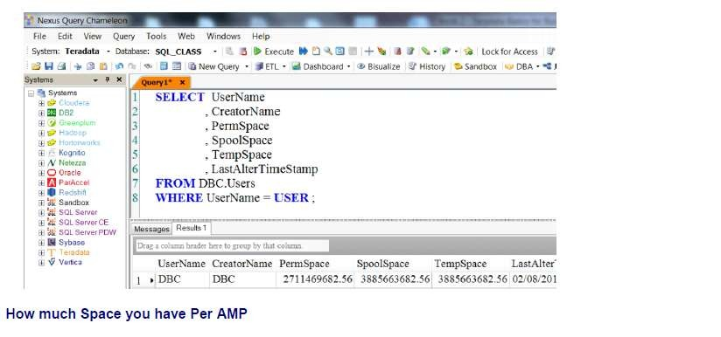
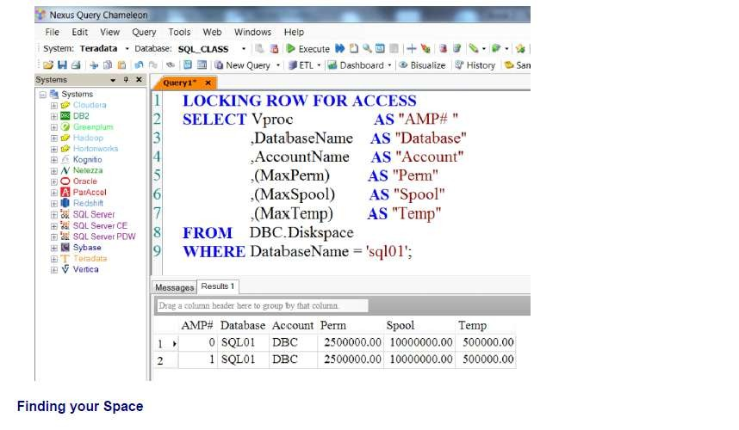
Teradata CoE
Teradata Lab Course

Slide 24
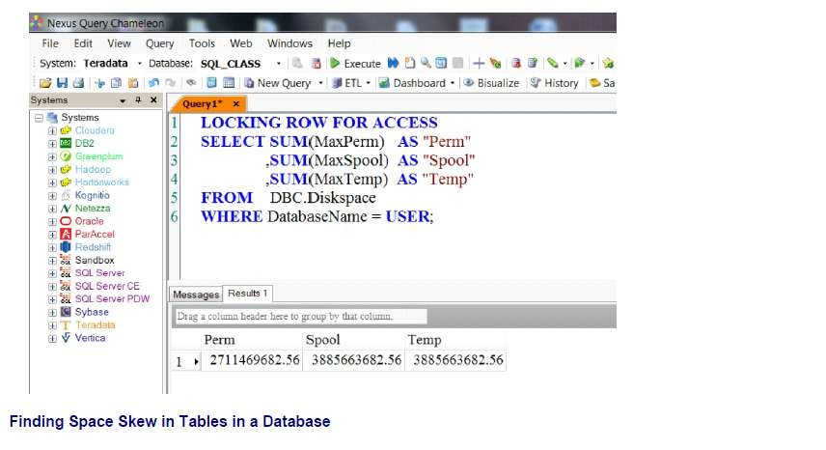
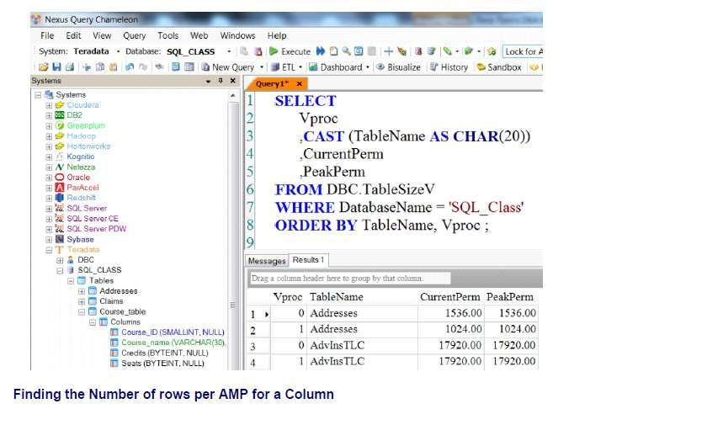
Teradata CoE
Teradata Lab Course

Slide 25
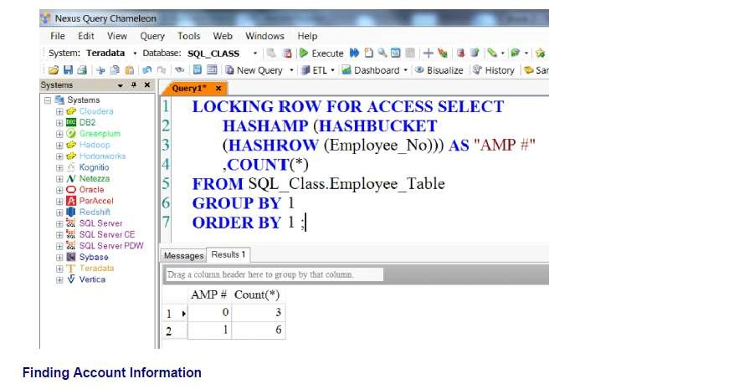
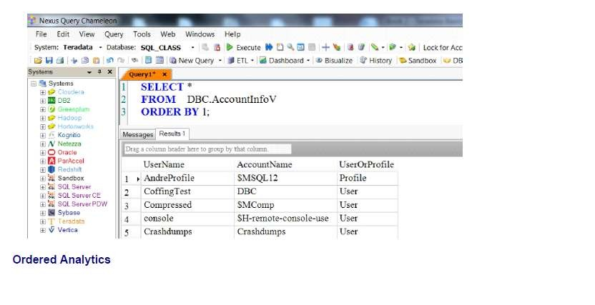
Teradata CoE
Teradata Lab Course

Slide 26
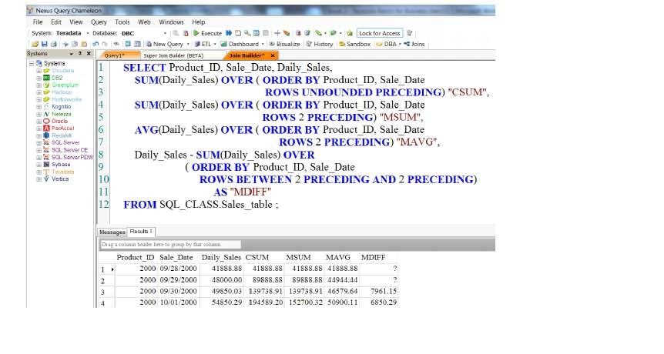
Teradata CoE
Teradata Lab Course

Slide 27
Teradata CoE
Teradata Lab Course
View Functions

Slide 28
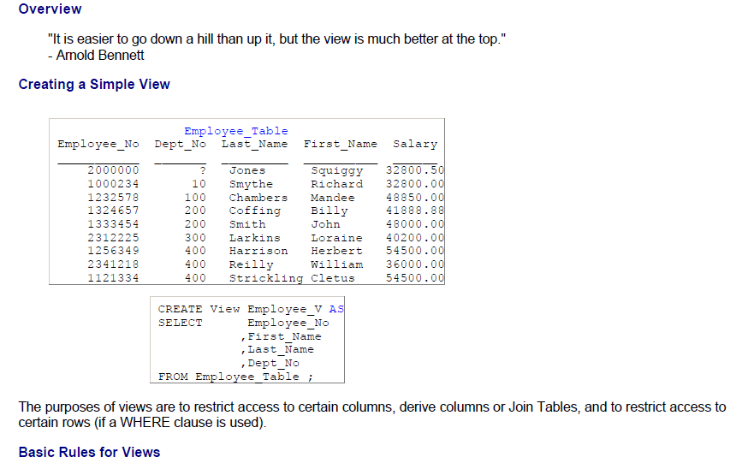
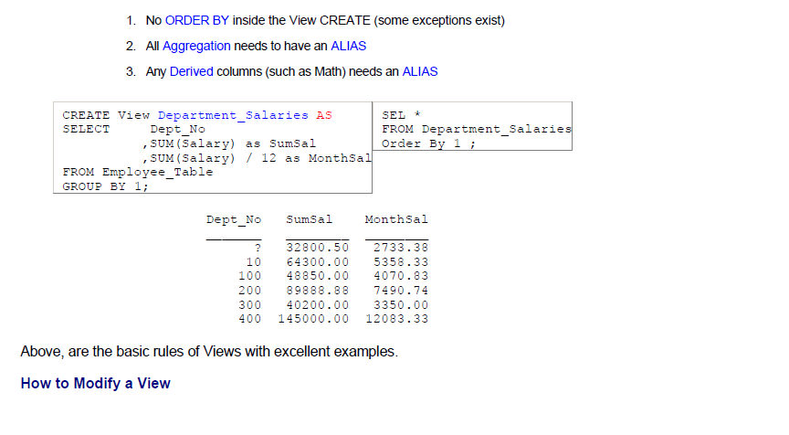
Teradata CoE
Teradata Lab Course
View Functions

Slide 29
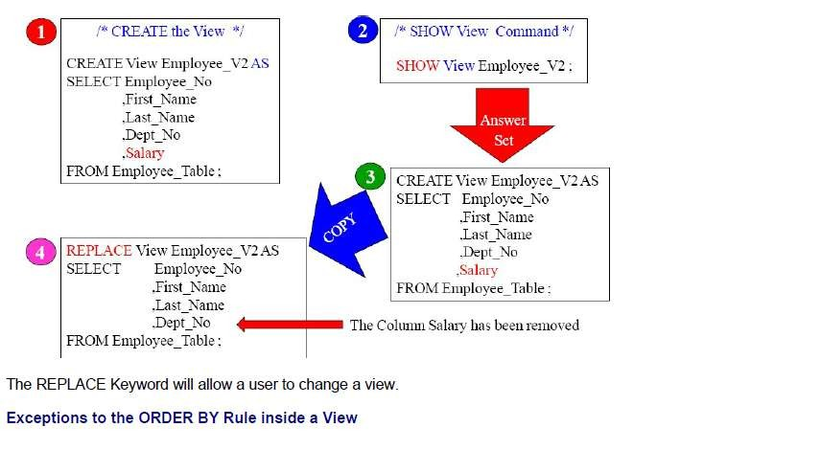
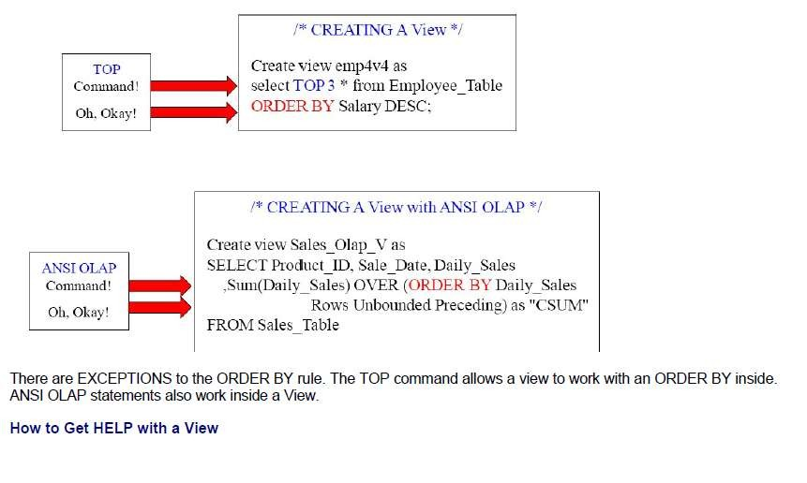
Teradata CoE
Teradata Lab Course

Slide 30
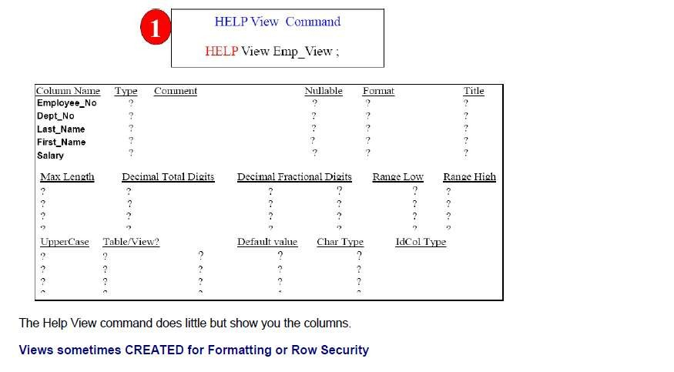

Teradata CoE
Teradata Lab Course

Slide 31


Teradata CoE
Teradata Lab Course

Slide 32


Teradata CoE
Teradata Lab Course

Slide 33



Teradata CoE
Teradata Lab Course

Slide 34


Teradata CoE
Teradata Lab Course

Slide 35


Teradata CoE
Teradata Lab Course

Slide 36


Teradata CoE
Teradata Lab Course

